Slide 1
Reversible Data Embedding for High Quality Images Using Interpolation and Reference Pixel Distribution Mechanism
Journal of Visual Communication and Image Representation, vol. 22, no. 2, pp. 131-140, 2011.
Speaker: Prof. Tung-Shou Chen

Slide 2

Outline
Overview – A brief history
Relative Works
Proposed Method
Experimental Results
Conclusion

Slide 3


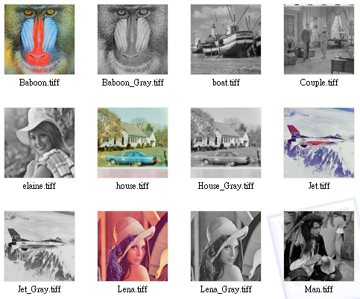



Overview (1/4)
The prisoners’ problem, Simmons (1983)
Alice
encryption key
Bob
stego key
00101…1
00101…1
Compression
Encryption
Decryption
Decompression
Image source
Communication is monitored by a warden looking for suspicious artifacts
Cover object
Stego-object

Slide 4
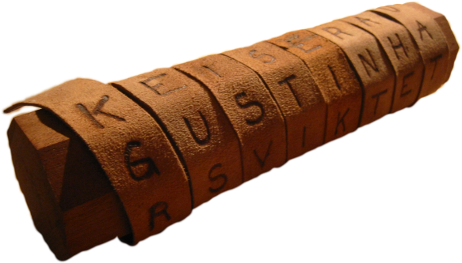
Overview (2/4)
Ancient Steganographic system
Skytale - a very simple mechanical Steganographic system developed by the Spartans during the 5th century.
Notes:
斯巴達

Slide 5

Overview (3/4)
Schwarzenegger’s letter (Hidden Message in Text File)
Notes:
施瓦辛格

Slide 6

Overview (4/4) - Reversible
Reversible
Secret Data
Encoder
Decoder
Cover Image
Stego Image
Secret Data

Slide 7









Relative Works –Tsai et al.’s Method
(2009)
Basic pixel
Non-basic pixels
image block
Create Difference Histogram
Perform Data Embedment

Slide 8
Example –Encoding
2. Shift Prediction Errors
Cover Image
E'
-2
0
0
1
1
1
2
4
4
6
6
6
6
7
1
4
6
0
-2
-2
0
-2
1
1
0
5
5
7
5
6
7
2
7
3. Modify Prediction Errors
5
6
9
5
5
6
3
5
8
E’’
-2
0
-1
1
1
1
2
4
1. Create Prediction Errors
0
-2
-2
-1
-2
1
1
0
1
1
1
2
3
4
5
6
7
8
E
-1
0
0
1
1
1
2
4
4. Stego Image
0
-1
-1
0
-1
1
1
0
3
6
6
6
5
7
Peak: 0 zero:-2 S={0 1 0 1}
5
5
7
4
6
7
4
6
9
4
4
6

Slide 9
Example –Decoding
Stego Image
3. Shift Prediction Errors
3
6
6
6
5
7
E’
-1
0
0
1
1
1
2
4
5
5
7
4
6
7
0
-1
-1
0
-1
1
1
0
4
6
9
4
4
6
4. Image Recovery
1. Constructed Modify Prediction Errors
3-(-1)=4
4
6
6
6
6
7
5
5
7
5
6
7
E’’
-2
0
-1
1
1
1
2
4
5-0=5
5
6
9
5
5
6
0
-2
-2
-1
-2
1
1
0
0
1
0
1
2. Extracted Secret Data

Slide 10
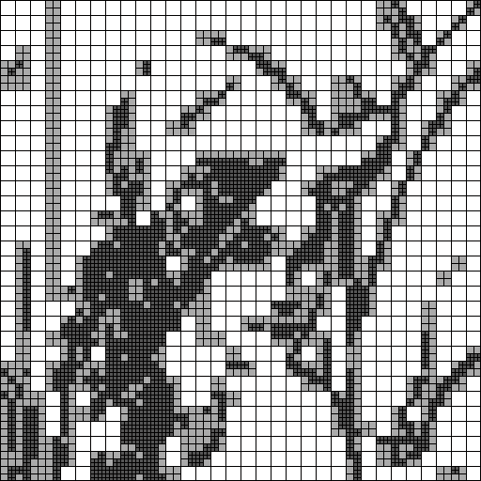
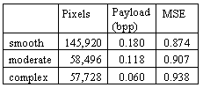
Proposed Method
  The distribution of smooth and complex regions of the Lena Image.
Smooth Region
Moderate Region
Complex Region

Slide 11
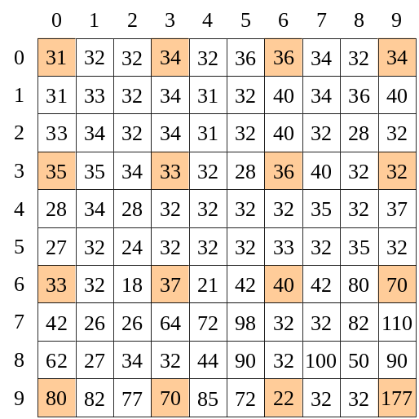
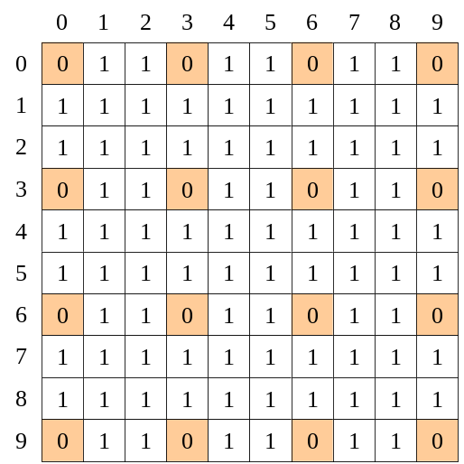
Reference Pixel Distribution Mechanism (1/2)
A binary image representing the locations of reference pixels is constructed according the local image activity.
Cover Image
Binary Image

Slide 12
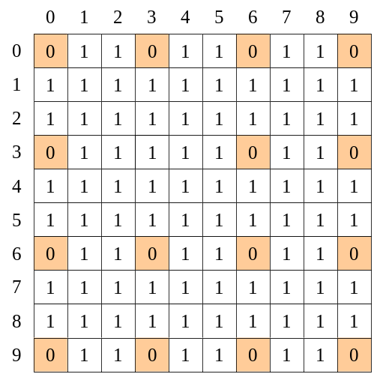
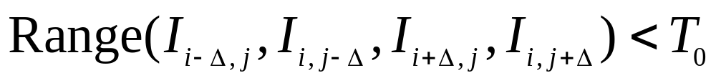
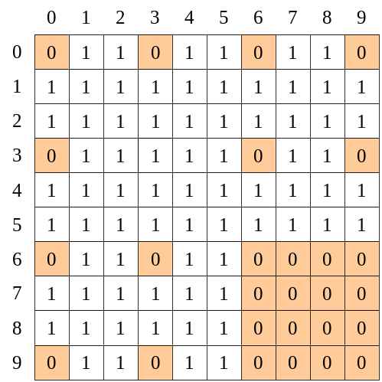
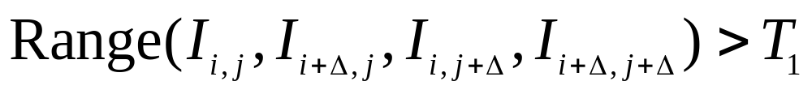
Reference Pixel Distribution Mechanism (2/2)
In smooth regions, less reference pixels are chosen to increase the capacity.
In complex regions, more reference pixels are chosen to reduce the distortion.

Slide 13
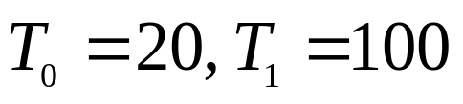
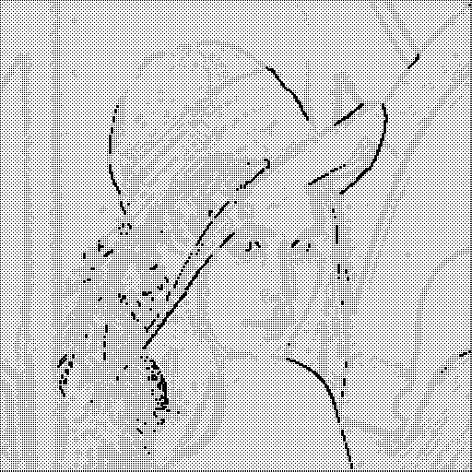
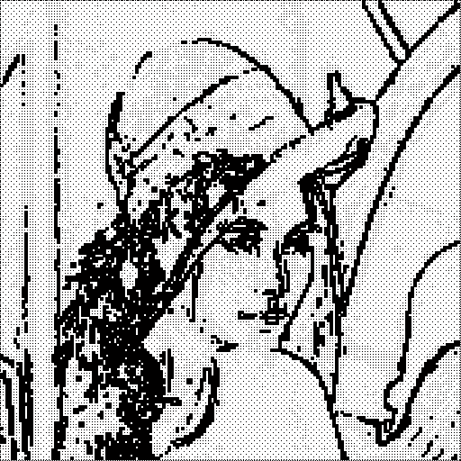


Binary Images
,

Slide 14
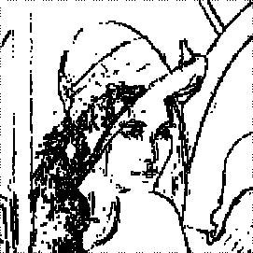


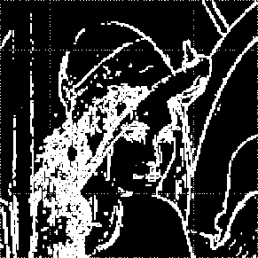




Embedding Procedures
Create binary image B
Interpolate image
Pre-process
Cover image I
B
P
Side Information
Embed
Secret Data
Stego image Is
Notes:
Pre-process: 0->1 and 255->254, record the location map Lm

Slide 15




Extraction & Recovery
Create binary image B
Interpolate image
Stego image Is
B
P
Extraction & Shifting
Side Information
Secret Data
Original image I

Slide 16
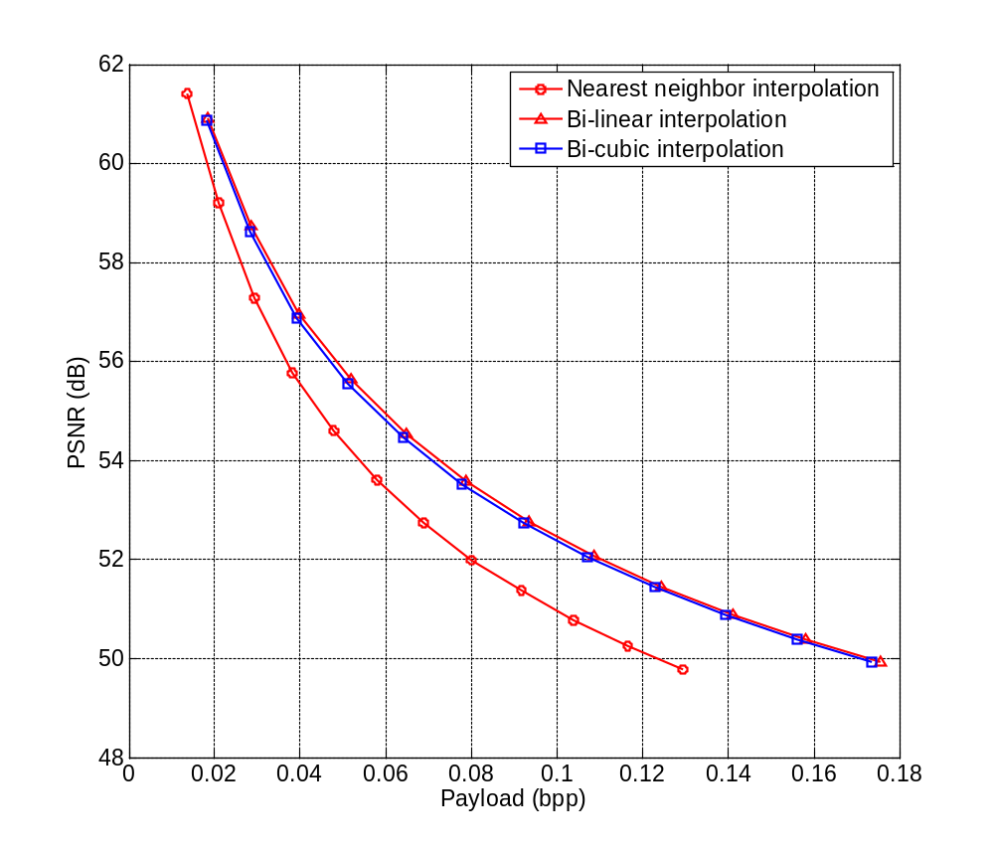




Experimental Results (1/5)
Results obtained from different interpolation methods for test image Lena

Slide 17
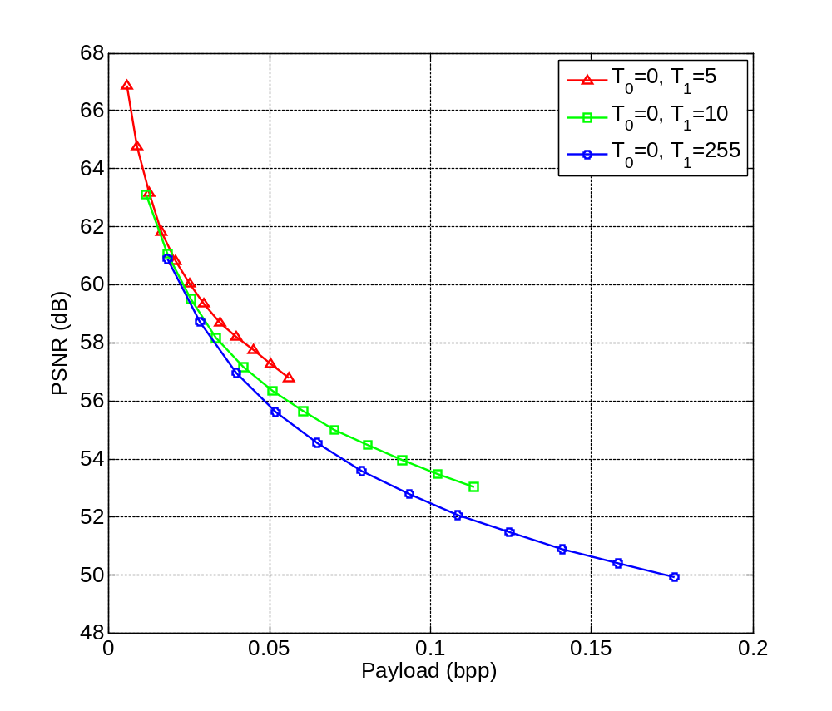


Experimental Results (2/5)
Comparison for various Thresholds T₁

Slide 18
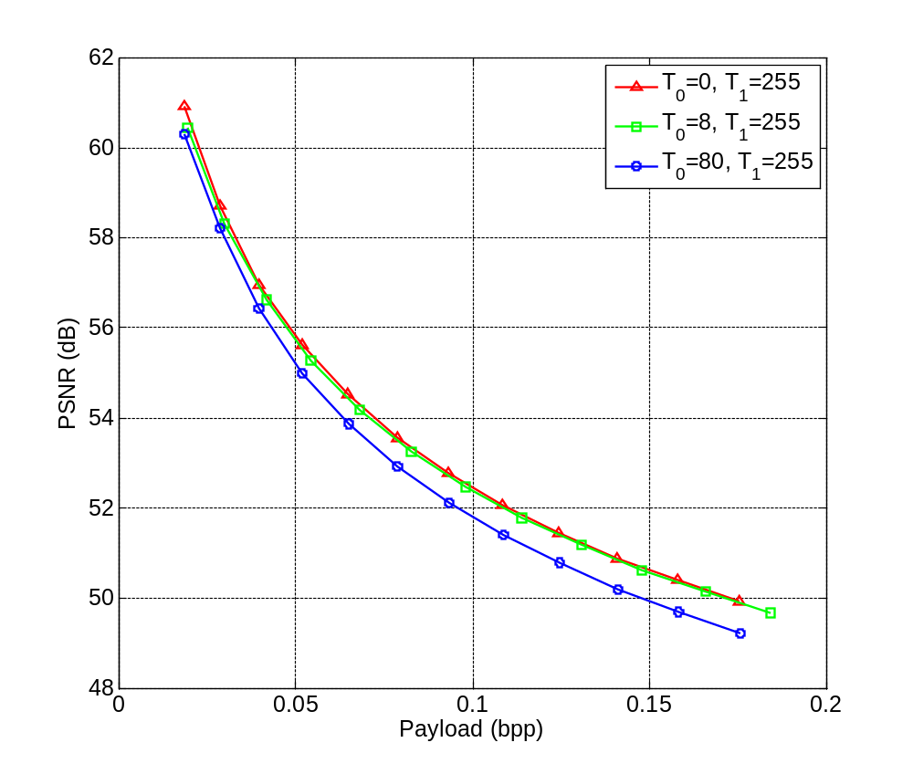
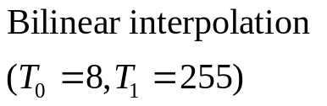
Experimental Results (3/5)
Comparison for various Thresholds T₀

Slide 19
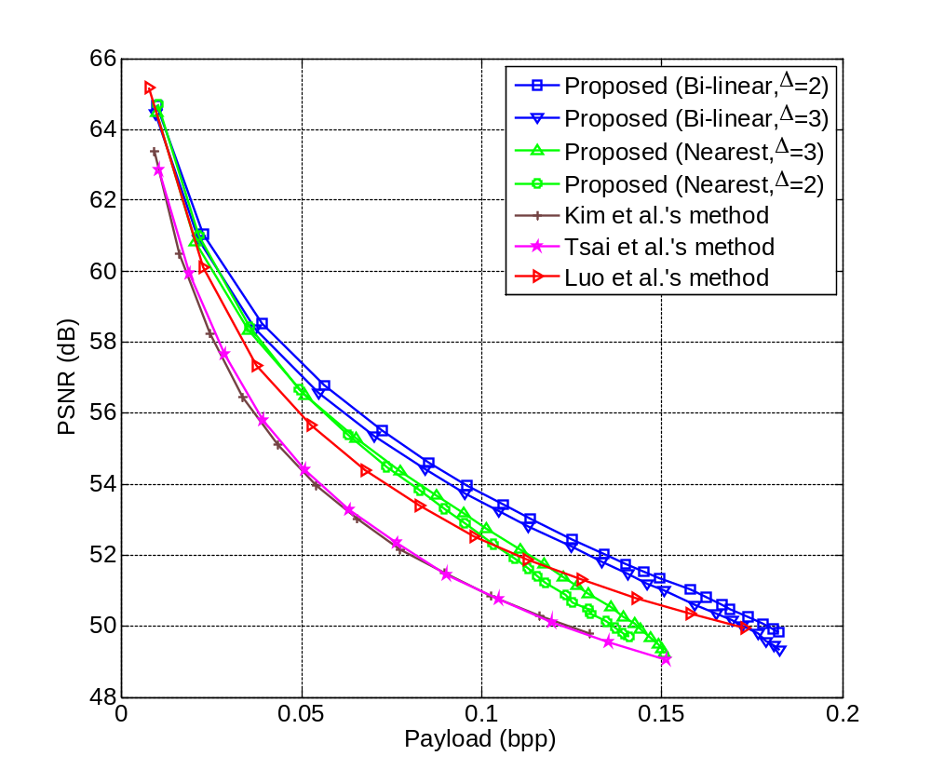










Experimental Results (4/5)
Performance Comparison for Various Payloads
Test Image: Lena

Slide 20
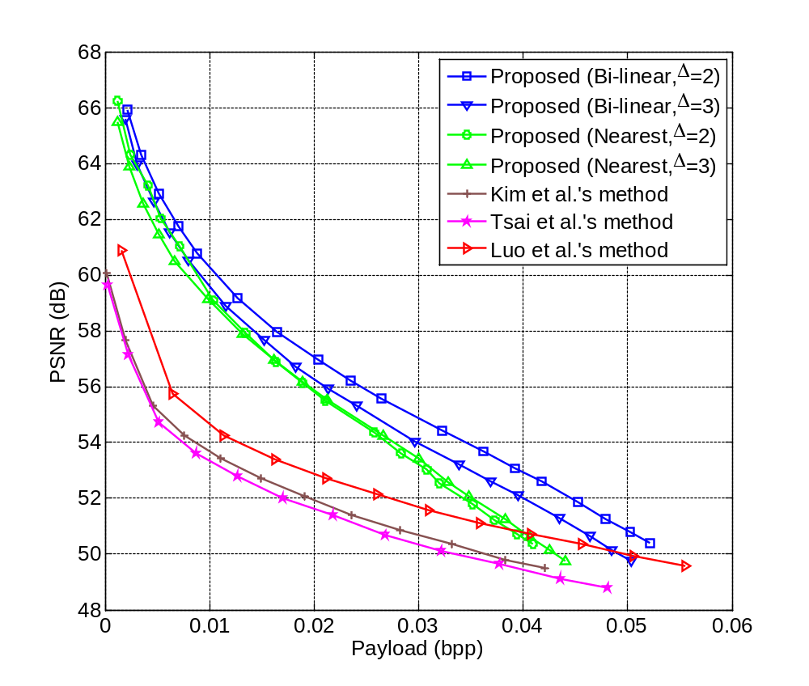


Experimental Results (5/5)
Performance Comparison for Various Payloads
Test Image: Baboon

Slide 21
Conclusion
Selectable prediction techniques
Offer a mechanism to add or remove reference pixels based on local image characteristics
Provide better image quality than previous works

Slide 22
Thank You

